Slide 1
Welcome to Comp 608:
Workplace Communication
for Computer Science Professionals
Prof. Mary Glavan and Prof. Mack Joyner

Slide 2
Welcome to
Comp 608
Class Agenda
Introduction to each other
Introduction to the course
Course Overview
Course Objectives
Assignments
Deadlines and Assessment
Attendance and Participation
Tuesday, Aug 25

Slide 3

Course Instructors
Mary R. Glavan, Ph.D
You can call me:
Dr. Glavan (most formal)
Dr. G (less formal)
Mary (informal)
Pronunciation Help
“Glove-on,” with the accent on the “on”
My Pronouns
she/her

Slide 4
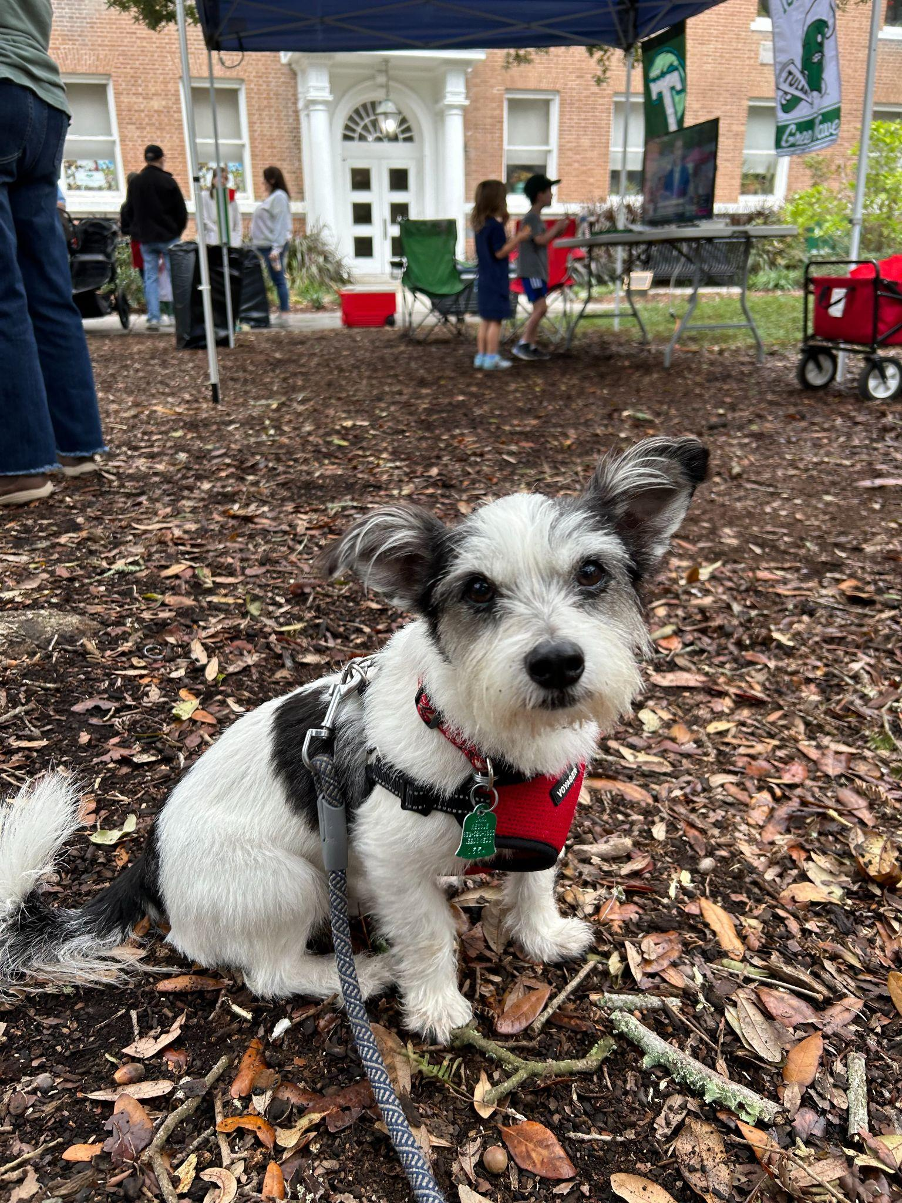
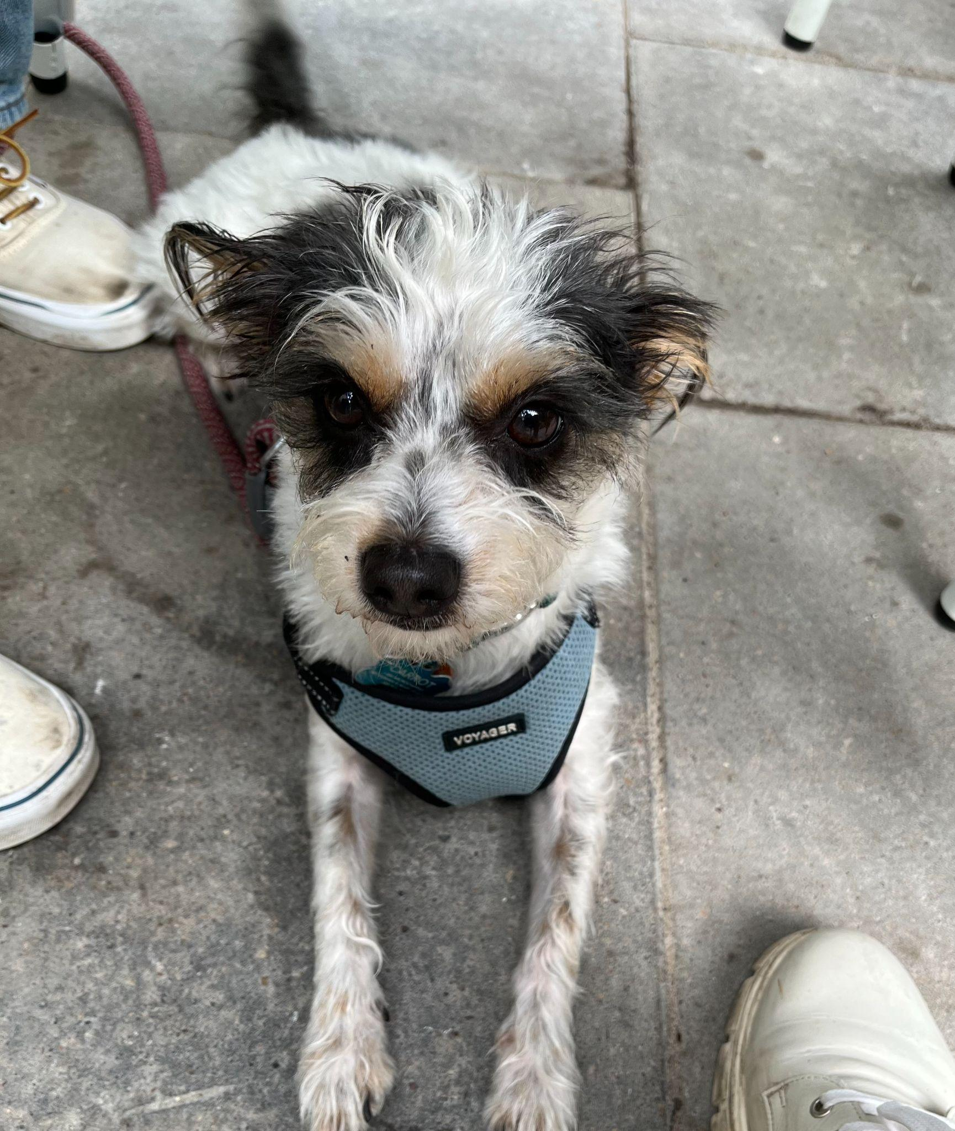
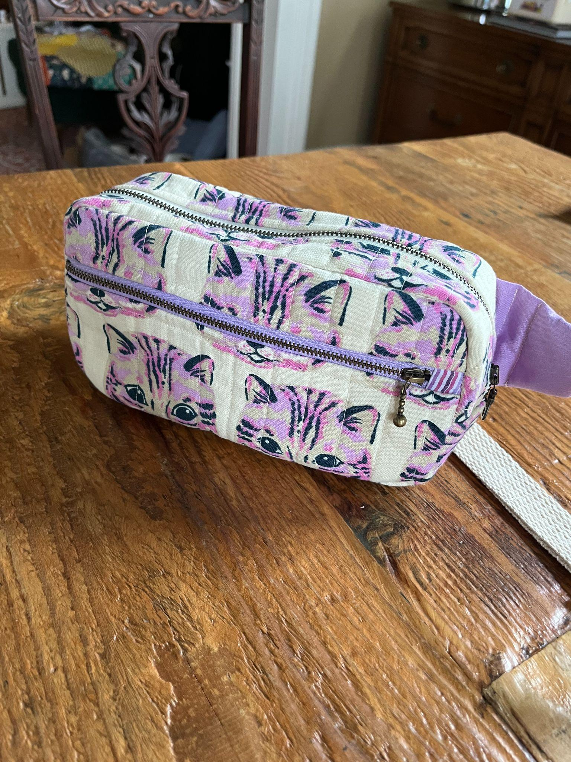
About Dr. G

Slide 5
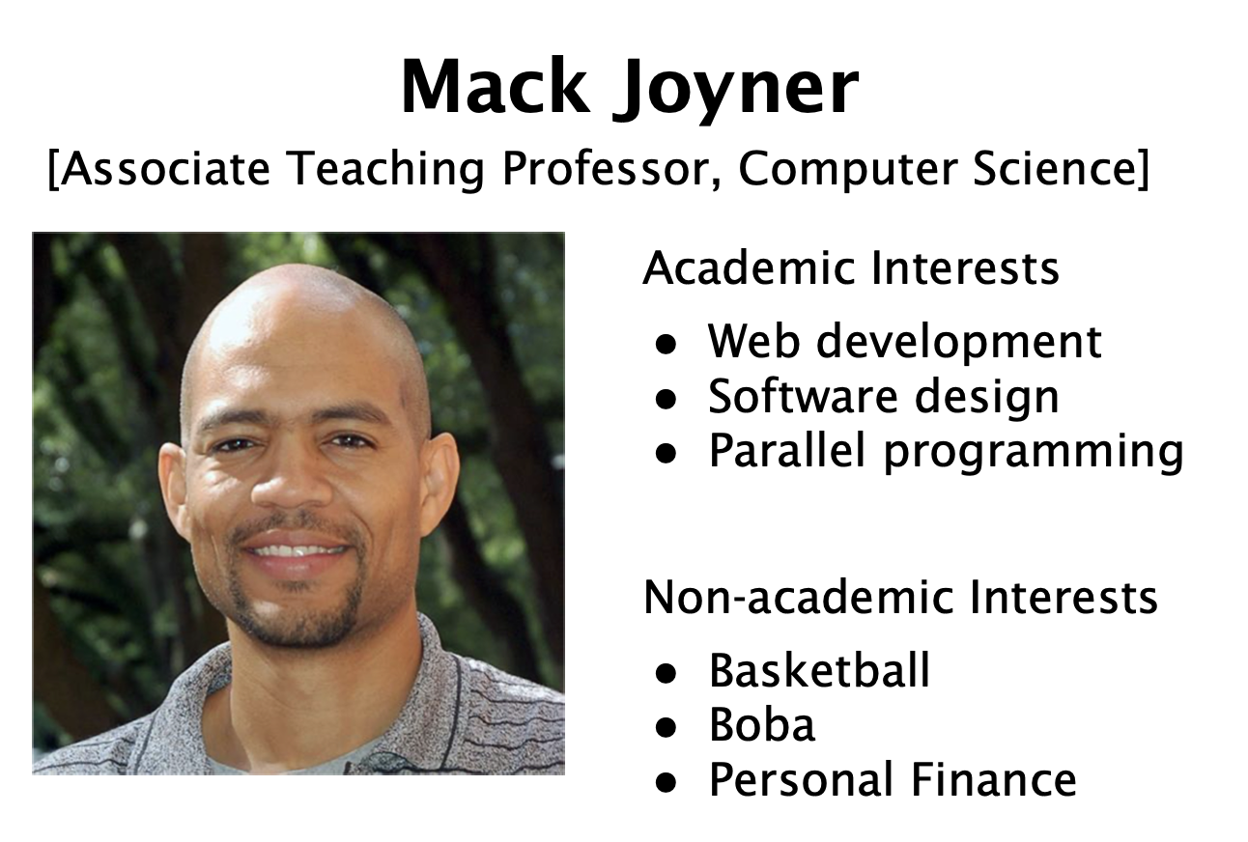
Course Instructors
Mack Joyner, Ph.D

Slide 6
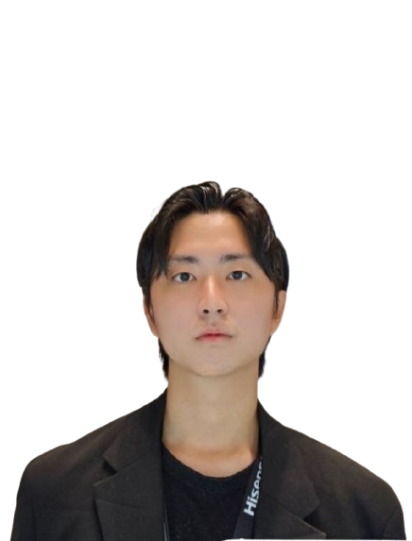
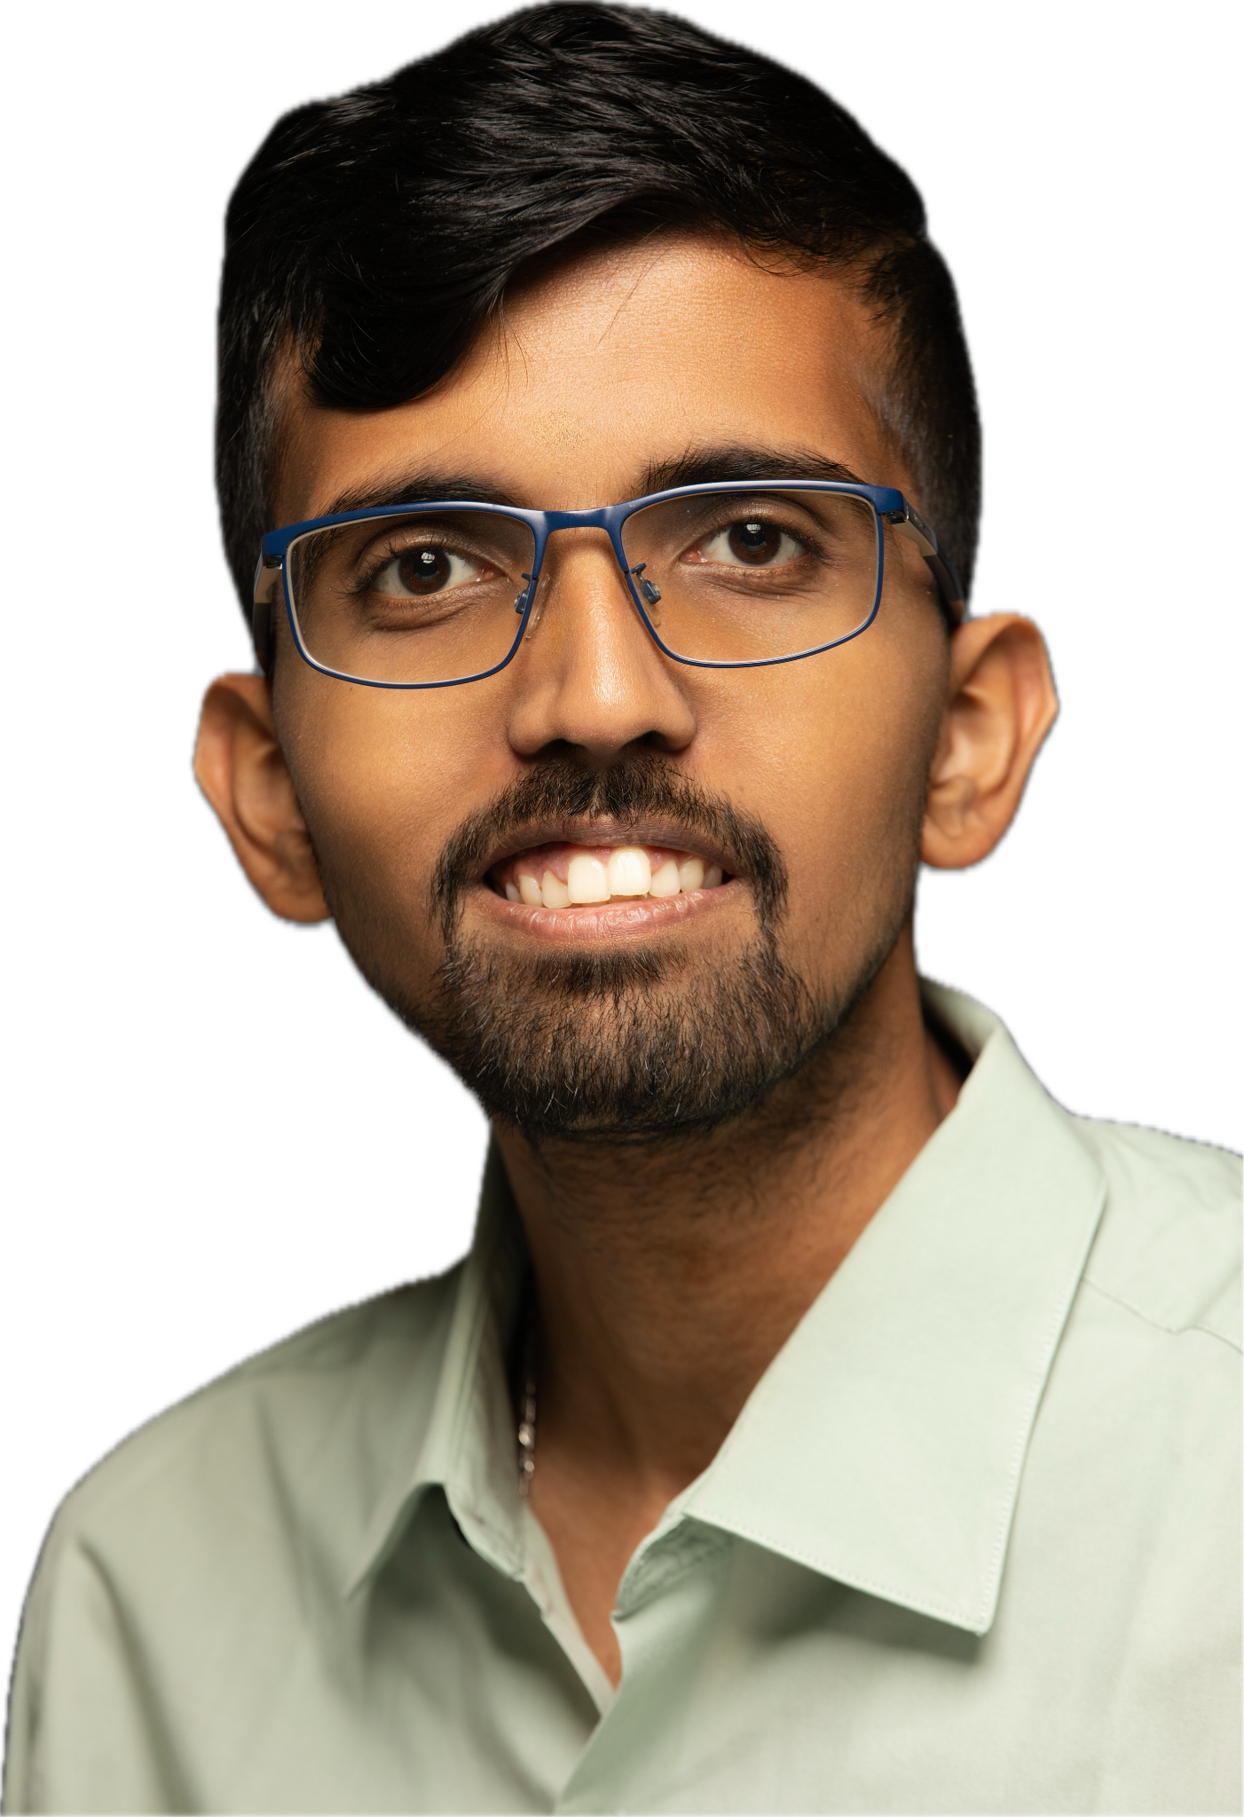
Course Teaching Assistants
SangWoo Park
Naga Shiva Harish Yedidi

Slide 7
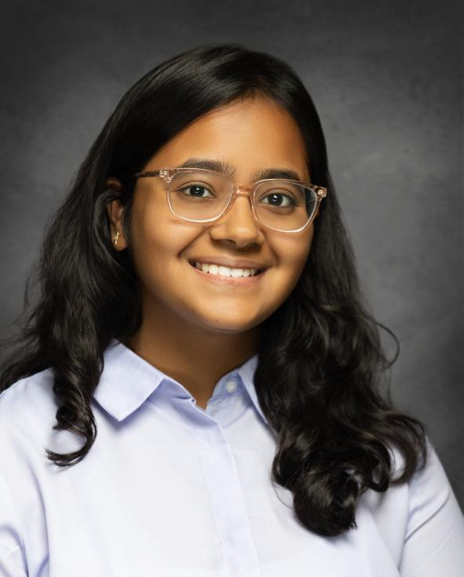
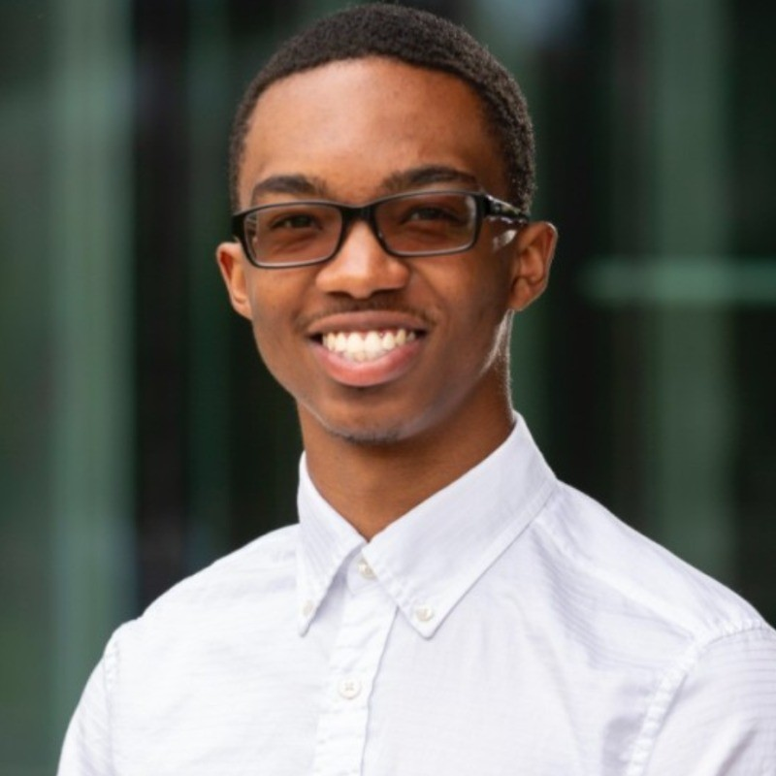
Course Teaching Assistants
Lajvi Bhavsar
Joshua-James Claybon

Slide 8

Introductions
Preferred name, pronunciation, and pronouns (if you want)
Where do you call “home”? Or where are you from? Or anythings else you’d like to tell us about you…
What are you hoping to learn from this class?
What’s your “big dream”?

Slide 9
Course Objectives: What will you Learn?
Understand and apply communication principles, including audience, genre, and purpose, to evaluate written, oral, and visual communication situations.
Develop and adapt communication strategies to create messages that align with audience needs, cultural norms, and organizational contexts.
Explain technical concepts, design decisions, and project outcomes effectively for different professional contexts and situations.
Apply interpersonal communication strategies to express yourself clearly, give and receive feedback respectfully, and manage team conflict effectively.
Create communication that effectively aligns with industry-standard formats and genres (e.g., emails, presentations, specifications).
Apply ethical reasoning to professional practices and make responsible communication and design decisions, including decisions about generative AI.

Slide 10
Professional Communication Principle #1
All communication has a beginning, middle, and end

Slide 11
What did people put in the BEGINNING of their self-introduction?
Name
Pronunciation
Pronouns?
MIDDLE?
END?
Place of origin
Interests, projects, family, hobbies, other?
Learning goals
Big dreams
Forward-looking statement (“I’m looking forward…”)
Compliment (“I’m thrilled to be surrounded by such a talented group of people.”)
Other?
Notes:
Image: https://ageofthrivability.com/files/2019/01/1yzgJ-66YvsokIvqw93jiJQ.png

Slide 12
Professional Communication Principle #2
All communication is mediated through the body

Slide 13
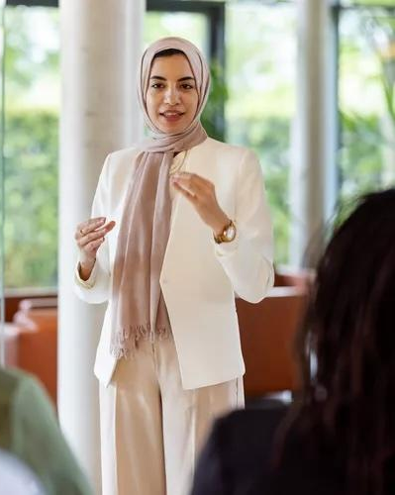
Public speaking anxiety (PSA) is one of our most common social fears, and it directly impacts our academic and professional success.
García-Monge A, et al. (2023) doi:10.3389/fnhum.2023.1268798.
Luis Alvarez / Getty Images

Slide 14
Public speaking anxiety affects your whole body
Mind & Focus | Racing thoughts; mind goes blank
Heart & Circulation | Increased heart rate and blood pressure
Breath & Voice | Shallow breathing; trembling voice
Muscles & Movement | Tense jaws or shoulders; shaking hands or knees

Slide 15
Anxiety is energy.
Awareness helps you turn it into presence.

Slide 16
What else do you want to learn?

Slide 17
Assessment Overview
Major Projects
Community Involvement: 10%
Attendance: 5%
Participation: 5%
Concept Quizzes: 15%
Communication Practice: 15%
Major Projects: 60%
Employment Portfolio (15%, Individual)
Interviews (10%, Team)
Software Documentation (15%, Team)
Oral Presentations (15%, Individual and Team)
Professional Communication Portfolio (5%, Individual)

Slide 18
Assessment and Deadlines
Major Assignments
Deadline windows or rolling deadlines
Submit any time during the window
Graded/feedback in order of submission
Late submissions receive penalties up to 10% of the project grade
Assessed using project specific rubrics, which will always be shared in advance.
Homework
Communication Practice (CPs)
Practice applying specific concepts and skills
Graded on completion and timeliness
Submit until last day of class
Concept Quizzes (CQ)
Short, out-of-class, open-note and book quizzes
Graded on correct answers and timeliness.
Take the quiz as many times as you like and submit until last day of class
All homework is due on Fridays at 11:59p CST.
Late CPs and CQs will receive a 10% point reduction, with a few exceptions.

Slide 19
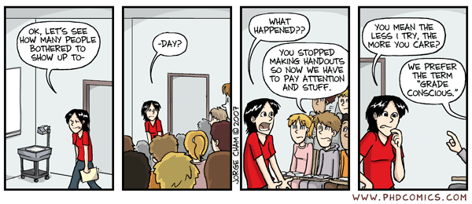
Community Involvement: Attendance
Sign-in on sign-in sheet each class period.
Try to be on time
2 typical absences = No problem!
3+ “typical” absences = starts affecting your grade
“Typical” absence = you miss class for reasons like minor illness, mental health day, travel, lectures or work for other classes.
“Atypical” = you miss class due to professional conferences, family or serious medical reasons, or religious observance.

Slide 20
Community Involvement: Participation
We encourage and expect you to actively contribute to our classroom community by:
Sharing your ideas with the class
Collaborating with your team members,
Giving and receiving feedback on coursework.
Participation Self Assessment
Review: Participation self-assessment rubric,

Slide 21

inclusive and accessible learning
agency to name ourselves
trust
community and collaboration
Notes:
Welcome to our class!

Slide 22
Office Hours are for YOU!
Dr. Glavan
Wednesdays: 1:15p - 4:00p
Duncan Hall 2114 or Zoom
Please book an appointment via the link on Canvas
Dr. Joyner
Mondays: 1:00p - 3:00p
Duncan Hall 2063
Drop-in

Slide 23
Office Hours are for YOU! I’m happy to help you with:
ENGI 501 course assignments that are confusing, challenging, or complicated
Writing emails and other important documents
Preparing answers for job interviews and job applications
Designing and practicing an upcoming oral presentation
Thinking through/about life as it relates to your academic and professional future
Pretty much anything else related to communication

Slide 24

How to Use the Comp 608 Canvas site
Use the Canvas Home Page as your starting point:
Access the weekly schedule (linked on the home page) for most questions related to what to do when
If you can’t find something, if a link is broken, or you don’t have access, please send us an email

Slide 25
How to prepare for our next class
Go to our Course Schedule (via Canvas, save as a GDrive shortcut)
Review the resources on the daily schedule for the next class:
Review: Generative AI Documentation Guidelines
Read and be ready to talk about:
“Salesforce Will Hire No More Software Engineers in 2025, Says Marc Benioff” (short article) OR
“Warning AI industry could use as much energy as the Netherlands”
Complete the weekly homework and assignments (right-hand column)
DUE FRIDAY 8/29, 11:59p
SUBMIT: Professional Communication Onboarding
CP #1: My Favorite AI Tool

Slide 26
How to use the Communication for Computer Science Leaders Canvas Site
Complete the professional communication onboarding:
Communication Self-Assessment Survey
Professional Master’s Students - Center for Career Development (CCD) Certificate
Upload your resume and CCD certificate to this Canvas site.
Learn about professional communication development opportunities

Slide 27



Slide 28
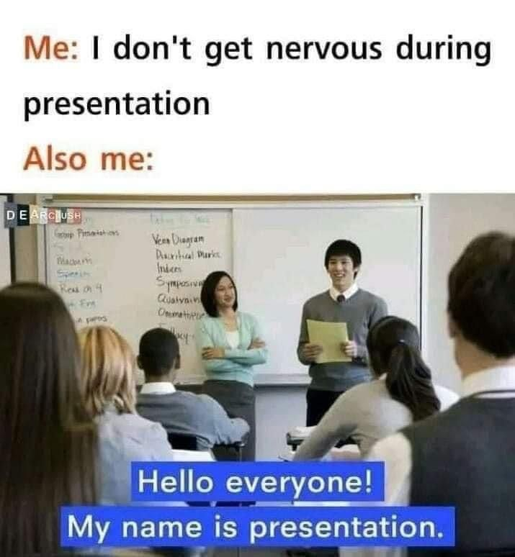
First-day Takeaways
This class is a community of practice.
This class will require your time and attention, but it’s designed for your success.
Come to class
Learn the course policies
Use Canvas and the Daily Schedule
We’re here to support you
All communication has a beginning, middle, and end
All communication is mediated through the body

Slide 29

Syllabus Activity (time dependent)
In small groups:
Review the syllabus and notice how the syllabus designed.
Name as many content and design techniques that you can find.
Which group can name the most?!

